Slide 1

B.Tech Project Evaluation-2, VIIIth Sem Project Title- Object Detection Software
Presented by :-
Chaitanya Kumar-180101091
Shiv Sharad Choudhary-180101295
Prashant Kumar-180101223
Under the Supervision of:-
( Mr. Gouri Shankar Mishra)
Sharda University, Gr. Noida
DEPARTMENT OF COMPUTER SCIENCE & ENGINEERING
SCHOOL OF ENGINEERING AND TECHNOLOGY
02, April, 2022
1

Slide 2
Approval from guide for the evaluation
Attach the screenshot of the email received from the guide

Slide 3
INDEX :
Sl No. | Contents
1 | Introduction-Slide 3
2 | Purpose & Scope-Slide 4
3 | Benefits-Slide 5
4 | What if?-Slide 6
5 | Software used –Slide 7
6 | Description of software- Slide 8
7 | Image description-Slide 10 to 18
8 | Implementation-Slide 14 to 15
9 | Conclusion –Slide 19

Slide 4
Project overview: Object Detection system is a great task, it is a vision Challenging Task. It is a critical part of many applications such as image search, image auto-annotation and scene understanding, object tracking. A number of successful single-object tracking system appeared, but in the presence of several objects detection becomes difficult and when objects are fully or partially occluded, they are obtruded from the human vision which further increases the problem of detection. Decreasing illumination and acquisition angle. The proposed of object identification system is made robust by an optimum selection of unique features and also by implementing the adaboost strong classification method. The object detection using shape and color involved in the Project is also significantly used And provide a sample to implement method. Basically, in this Object identification software can identify what type of object is it? It will give the result from the given input taken from the source.

Slide 5
Workload distribution of the team 1. Chaitanya Kumar – Software Development, PPT, Report 2. Shiv Sharad Choudhary – Report , Research Paper, Data base collection 3. Prashant Kumar – Research Paper, Report

Slide 6
Libraries used for developing software Tenserflow- TensorFlow is a free and open-source software library for machine learning. Numpy- NumPy is a library for the Python programming language, adding support for large, multi-dimensional arrays and matrices, along with a large collection of high-level mathematical functions to operate on these arrays. Pandas - pandas is a software library written for the Python programming language for data manipulation and analysis.

Slide 7
Matplotlib.image- The image module in matplotlib library is used for working with images in Python. The image module also includes two useful methods which are imread which is used to read images and show which is used to display the image. Skimage- scikit-image is an open-source image processing library for the Python programming language. Cv2- If the image cannot be read (because of missing file, improper permissions, unsupported or invalid format) then this method returns an empty matrix

Slide 8
Module used for graph Matplotlib.pylot- matplotlib. pyplot is a collection of functions that make matplotlib work like MATLAB. Each pyplot function makes some change to a figure: e.g., creates a figure, creates a plotting area in a figure, plots some lines in a plotting area, decorates the plot with labels, etc.

Slide 9
Data Set In first phase we will be trained the project with 10 epochs which gave us the accuracy of 72% maximum. Furniture. Metals etc. The image data set used in software will have a range dimension of 500*300.

Slide 10
Algorithms used for implementing software.
Machine learning- machine learning gave us the idea of implementing software with various tools and artificial intelligence.
Deep learning- Deep learning is an artificial intelligence (AI) function that imitates the workings of the human brain in processing data and creating patterns for use in decision making. ... Also known as deep neural learning or deep neural network.
We used CNN algorithm for the software production.

Slide 11
Improvement/Work done from the last evaluation
After previous evaluation we improved the accuracy up to 99% and made 3 more coding sessions for the accuracy.
We ran at least 15 epochs for the accuracy we were getting minimum accuracy of 88% in the latest software code.
And Maximum accuracy f 99%.

Slide 12
Total Training Images
Classes | Training Images | Validation Images | Total Images
Bed | 900 | 100 | 1000
Chair | 900 | 100 | 1000
Sofa | 900 | 100 | 1000
Swivel Chair | 900 | 100 | 1000
Table | 900 | 100 | 1000
Total Images | 4500 | 500 | 5000

Slide 13
Model Included in the Project
Model Name | Size (MB) | Parameters (Millions) | Depth
VGG-16 | 528 | 138.3 | 23
VGG-19 | 549 | 143.6 | 26
DenseNet-121 | 33 | 8 | 121
Inception V3 | 92 | 23.8 | 159

Slide 14
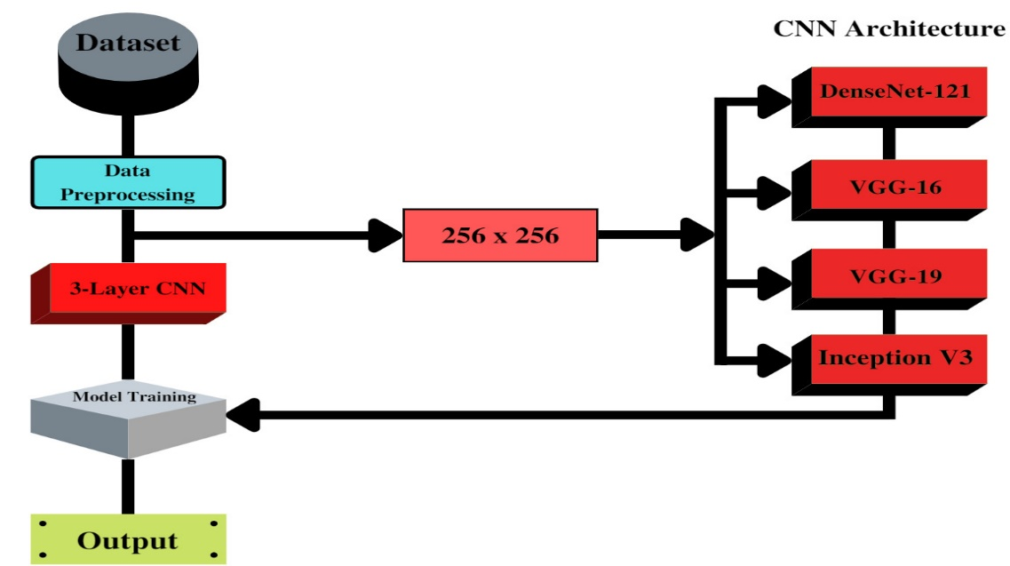
Implementation Work

Slide 15
Algorithm Used for The Project
For the implementation we used CNN algorithm.
CNN Algorithm: A Convolutional Neural Network (ConvNet/CNN) is a Deep Learning algorithm which can take in an input image, assign importance (learnable weights and biases) to various aspects/objects in the image and be able to differentiate one from the other. The pre-processing required in a ConvNet is much lower as compared to other classification algorithms. While in primitive methods filters are hand-engineered, with enough training, ConvNets have the ability to learn these filters/characteristics.

Slide 16
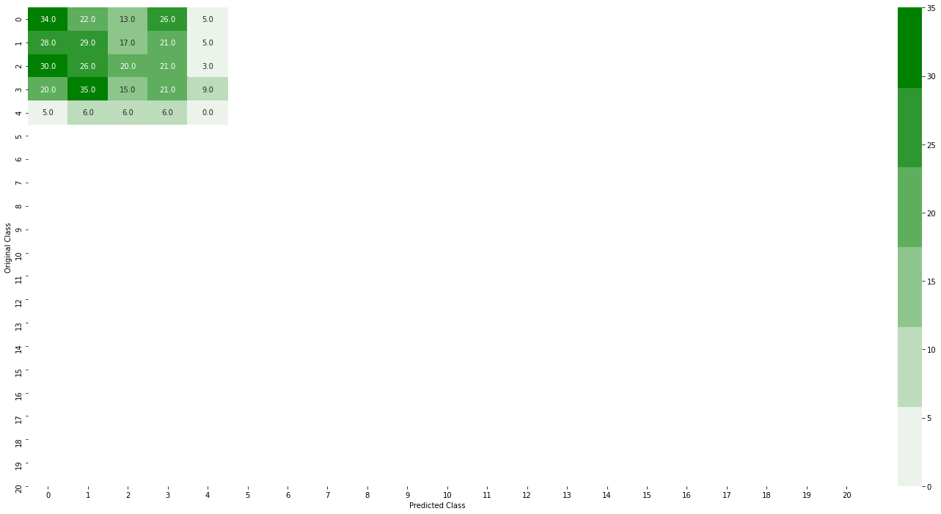
Confusion created by the previous software.

Slide 17
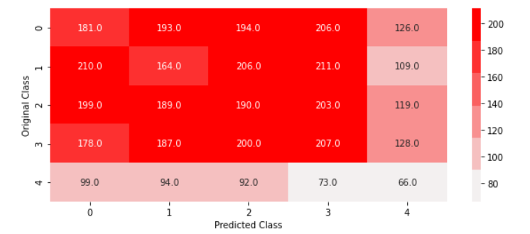
Confusion Matrix created by the new software.

Slide 18
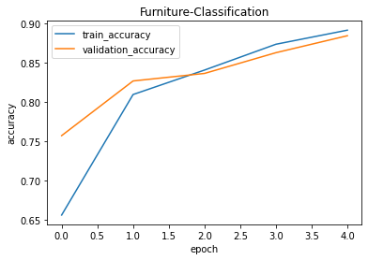
Graph Created by the Previous Software

Slide 19
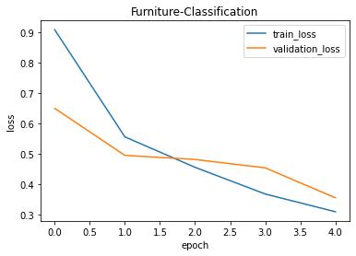
Graph 2

Slide 20
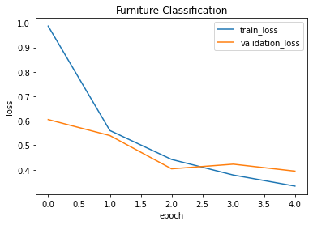
Graph Created by the New Software

Slide 21
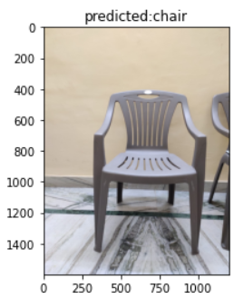
Result of the Project
As we can see the software has successfully predicted the image.

Slide 22
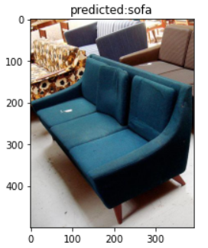
Result Image 2
As we can see the software has predicted the image.

Slide 23
Conclusion
Accurately locating an object in a surveillance video is one of the most important research areas in computers imaginable and has a wide range of cutting-edge programs in modern times. In the present day it is very difficult to cut modern day leaves such as low resolution, models of lights, moving objects beyond the ancient, small adjustments in the historical past, due to subsequent gadget photographs obtained from a surveillance video. We have presented a top degree visual development in item detection strategies. The detection approach takes place in background modelling, item detection, and object categories. In this paper, all available item detection strategies are classified into history subtraction, optical float and spatial-temporal filter out techniques and the advantages and drawbacks of today's techniques implemented in many modern-day datasets are referenced. Object type techniques are further categorized into strategies based on form-based thoroughness, movement-based and texture-based altogether.
In this paper, authors presented a comparative study of five Convolutional Neural Network Models classification of object detection. Out of the models under study VGG-19 outperformed all other in terms of accuracy. VGG-19 achieved an accuracy of 99.89% on training dataset, 99.87% accuracy on validation dataset and after testing on different furniture images, model obtained 98.47% accuracy.

Slide 24
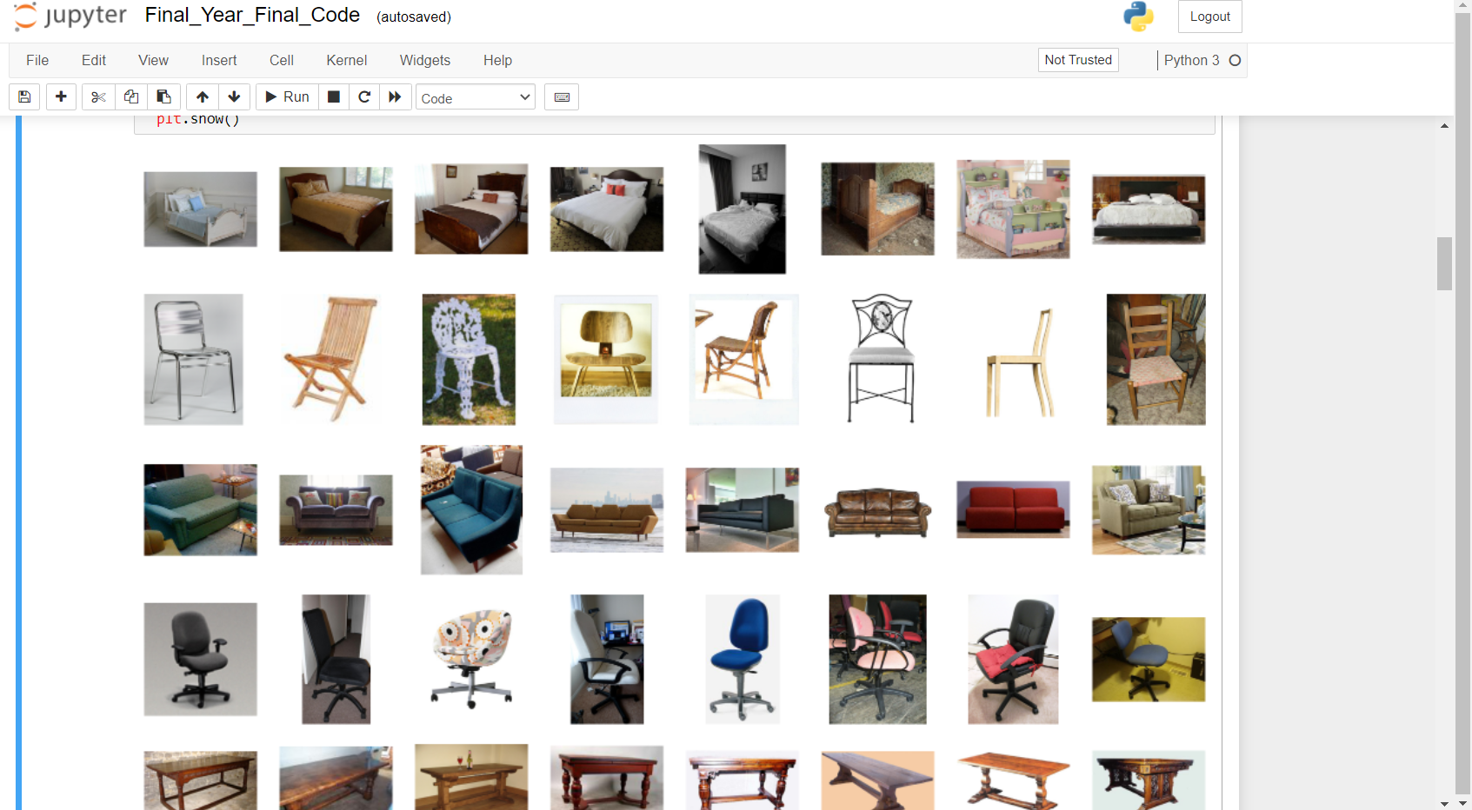
Trained Images Of the Software

Slide 25
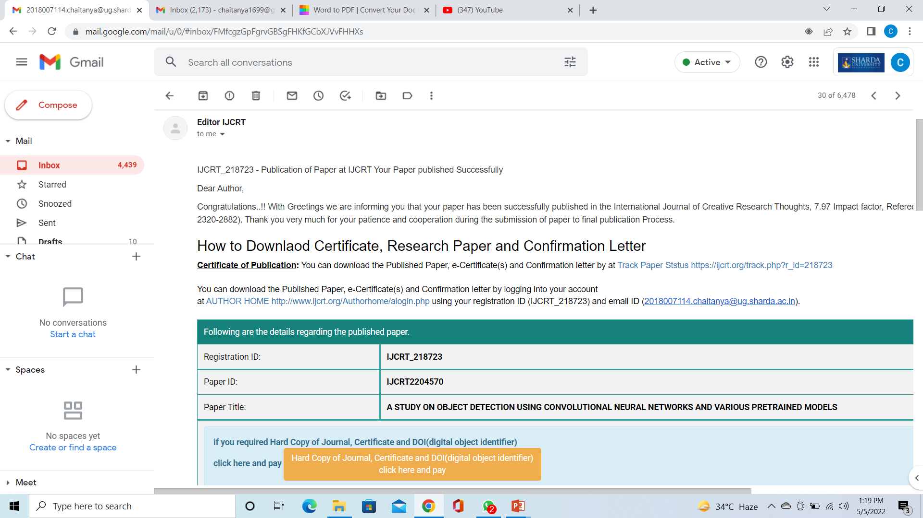
Proof of paper accepted or communicated/ Hackathon/ Patent

Slide 26
Thank you
ANY QUESTIONS?

